Slide 1
Regularization for Deep Learning
Adapted from Lecture slides of Deep Learning By Ian Goodfellow

Slide 2
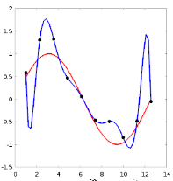
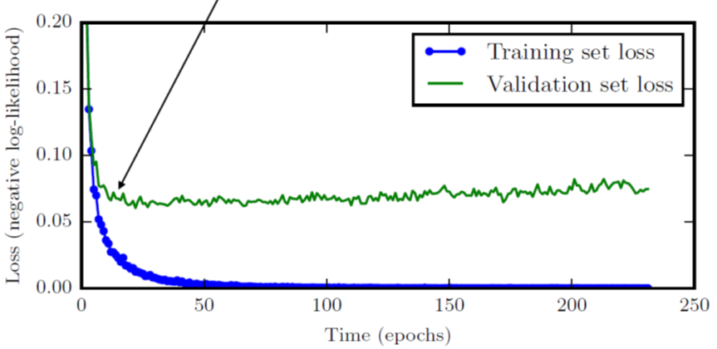
Definition of Regularization
Regularization is any modification we make to a learning algorithm that is intended to reduce its generalization error but not its training error.
The function in blue overfits the training data.

Slide 3
Techniques of Regularization
L1, L2 weight decay
Data augmentation
Translate, rotate, scale, flip, shear, skew
Crop, noise, contrast, brightness
Multi-tasking learning
Early stopping
Bagging
Dropout
Adversarial examples
Tangent propagation

Slide 4

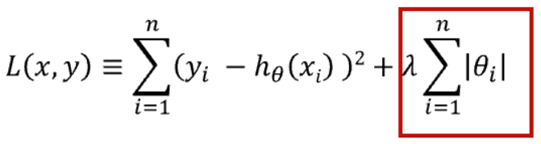
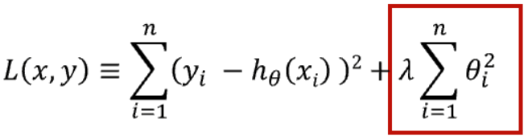
L1 and L2 Weight Decay Regularization
L1
Encourages sparsity, equivalent to MAP Bayesian estimation with Laplace prior
Squared L2
Encourages small weights, equivalent to MAP Bayesian estimation with Gaussian prior
or
or

Slide 5
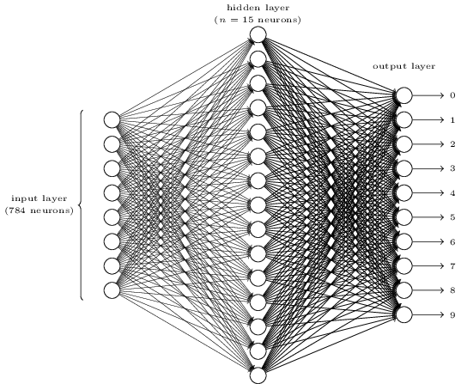
Applying L2 Regularization and Batch Normalization
from keras.datasets import mnist
import numpy
from keras.datasets import mnist
from keras.models import Sequential
from keras.layers import Dense
from keras.utils import np_utils
(X_train, y_train), (X_test, y_test) = mnist.load_data()
Input
784
num_pixels = X_train.shape[1] * X_train.shape[2] #28*28 = 784
X_train = X_train.reshape(X_train.shape[0], num_pixels).astype('float32')
X_test = X_test.reshape(X_test.shape[0], num_pixels).astype('float32')
1000
y_train = np_utils.to_categorical(y_train)
y_test = np_utils.to_categorical(y_test)
num_classes = y_test.shape[1]
10
Output
model = Sequential()
model.add(Dense(1000, input_dim=784, activation='relu', kernel_regularizer = l2(0.01)))
model.add(BatchNormalization())
model.add(Dense(10, activation='softmax', kernel_regularizer = l2(0.01)))
from keras.optimizers import Adam
model.compile(loss='categorical_crossentropy', optimizer='adam', metrics=['accuracy'])
history = model.fit(X_train, y_train, validation_data=(X_test, y_test), epochs=100, batch_size=1024, verbose=1)
verbose:
0: 安靜模式
1: 進度條
2: 每輪一行
Notes:
784 = 28*28

Slide 6
Dataset Augmentation
Machine learning model generalize better when trained on more data
Effective for object recognition tasks
Translating, rotating or scaling the training images
Python package: Augmentor
Effective for speech recognition tasks
Injecting noise in the input or the hidden units to a neural network
Augmentation
Training Data
Augmented Training Data

Slide 7
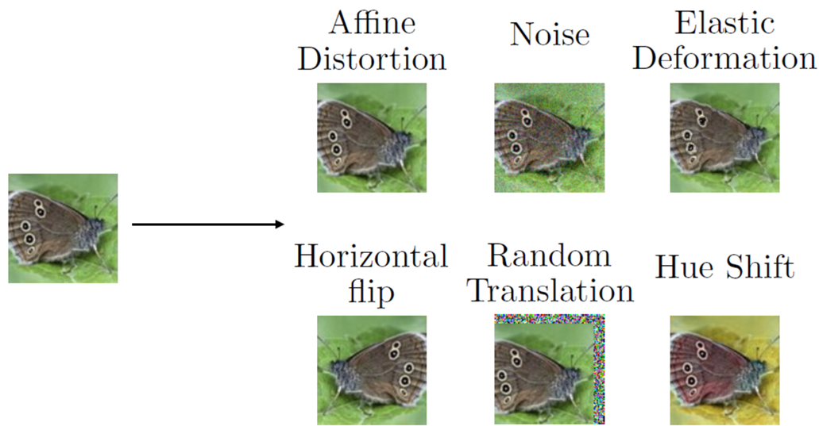
Dataset Augmentation
Notes:
Hue: 色彩

Slide 8
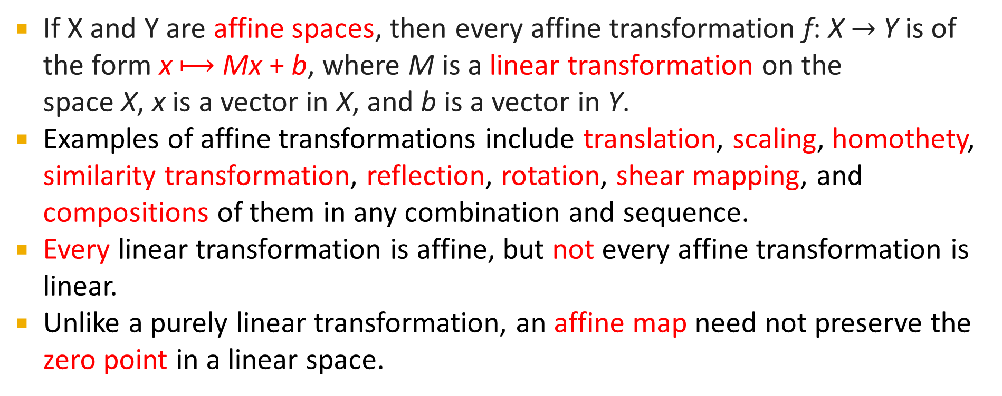
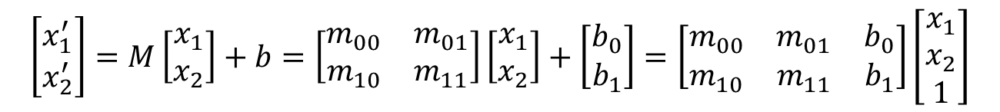
Affine Transformation
If X and Y are affine spaces, then every affine transformation f: X$→$Y is of the form x $⟼$Mx + b, where M is a linear transformation on the space X, x is a vector in X, and b is a vector in Y.
Examples of affine transformations include translation, scaling, homothety, similarity transformation, reflection, rotation, shear mapping, and compositions of them in any combination and sequence.
Every linear transformation is affine, but not every affine transformation is linear.
Unlike a purely linear transformation, an affine map need not preserve the zero point in a linear space.
$$\left[\begin{matrix}x_{1}^{′} \\ x_{2}^{′}\end{matrix}\right]=M\left[\begin{matrix}x_{1} \\ x_{2}\end{matrix}\right]+b=\left[\begin{matrix}m_{00} & m_{01} \\ m_{10} & m_{11}\end{matrix}\right]\left[\begin{matrix}x_{1} \\ x_{2}\end{matrix}\right]+\left[\begin{matrix}b_{0} \\ b_{1}\end{matrix}\right]=\left[\begin{matrix}m_{00} & m_{01} & b_{0} \\ m_{10} & m_{11} & b_{1}\end{matrix}\right]\left[\begin{matrix}x_{1} \\ x_{2} \\ 1\end{matrix}\right]$$
Mx + b
Notes:
Affine: 遠交的、仿射的；Homothety: 相似的、同位的；shear: 切割

Slide 9
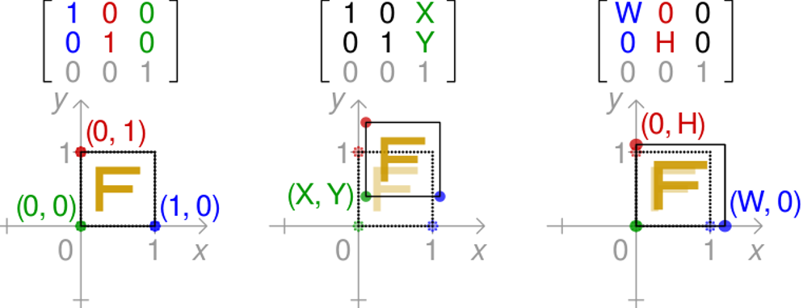
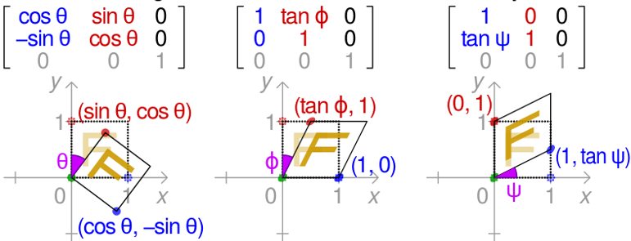
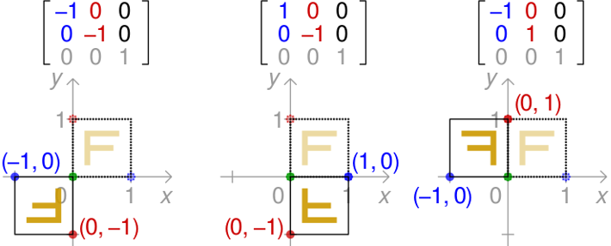
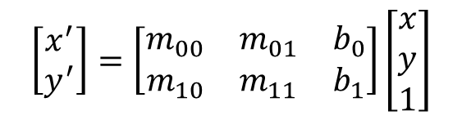
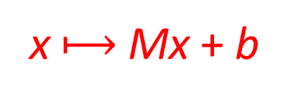
Affine Transformations
x $⟼$Mx + b
Combining M and b, we can write
$$\left[\begin{matrix}x^{′} \\ y^{′}\end{matrix}\right]=\left[\begin{matrix}m_{00} & m_{01} & b_{0} \\ m_{10} & m_{11} & b_{1}\end{matrix}\right]\left[\begin{matrix}x \\ y \\ 1\end{matrix}\right]$$

Slide 10
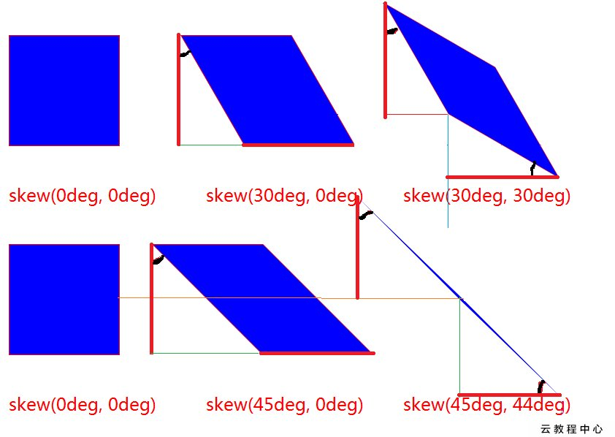
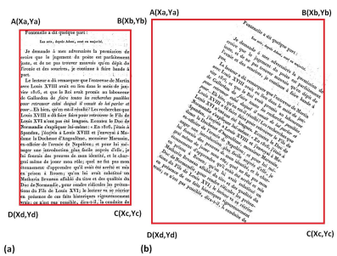

Slide 11
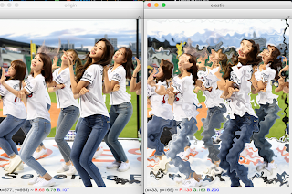
Elastic Deformation
o_img = cv2.imread(‘izone_oy.png’) # OpenCV library
elMat = elastic(o_img, alpha=5000, sigma=8, random_state=None)
Notes:
Elastic 伸縮、鬆緊帶

Slide 12


Crop and Resize Image
Image cropping for data augmentation
Crop in the right, left, center, top or bottom of the image.

Slide 13
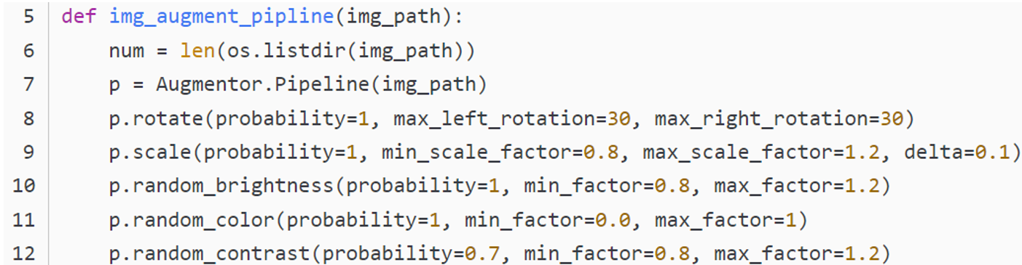
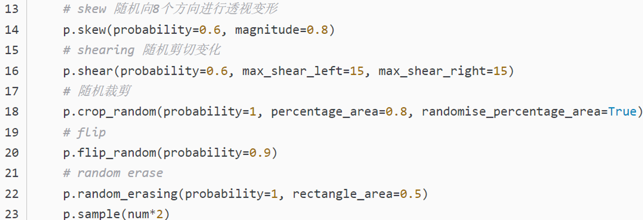

Slide 14
Multi-Task Learning
Task1 Task2
Multi-task learning is a way to improve generalization by pooling the examples arising out of several tasks.
Additional training examples put more pressure on the parameters of the model, when part of a model is shared across tasks, that part of the model is more constrained toward good values, often yielding better generalization.
Task3

Slide 15
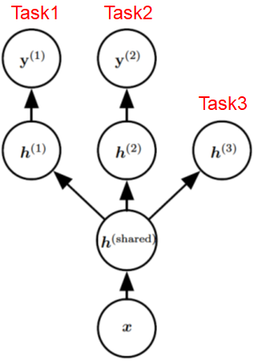
Multi-Task Learning
Supervised
Multi-task learning can be cast in several ways in deep learning frameworks and this figure illustrates the common situation where the tasks share a common input but involve different target random variables.
The lower layers of a deep network (whether it is supervised and feedforward or includes a generative component with downward arrows) can be shared across such tasks, while task-specific parameters (associated respectively with the weights into and from h⁽¹⁾ and h⁽²⁾ can be learned on top of those yielding a shared representation h^{(shared)}. The underlying assumption is that there exists a common pool of factors that explain the variations in the input x, while each task is associated with a subset of these factors.
Unsupervised
In this example, it is additionally assumed that top-level hidden units h⁽¹⁾ and h⁽²⁾ are specialized to each task (respectively predicting y⁽¹⁾ and y⁽²⁾ ) while some intermediate-level representation h^{(shared)} is shared across all tasks.
In the unsupervised learning context, it makes sense for some of the top-level factors to be associated with none of the output tasks (h⁽³⁾): these are the factors that explain some of the input variations but are not relevant for predicting y⁽¹⁾ or y⁽²⁾ .

Slide 16
Early Stopping
Early stopping:
terminate while validation set performance is better
Learning curves showing how the negative log-likelihood loss changes over time (indicated as number of training iterations over the dataset, or epochs).
Observe that the training objective decreases consistently over time, but the validation set average loss eventually begins to increase again, forming an asymmetric U-shaped curve.
E.g., Patience = 20
If validation error does not improve in 20 epochs, then stop.

Slide 17
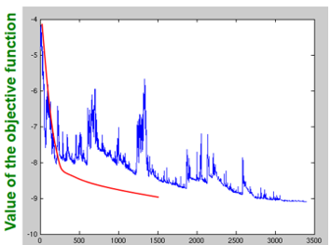
What if set patience < 20?
20

Slide 18
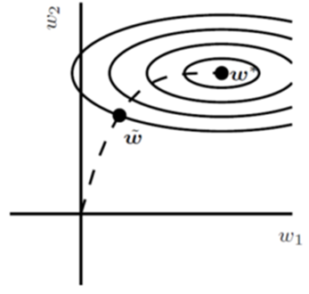
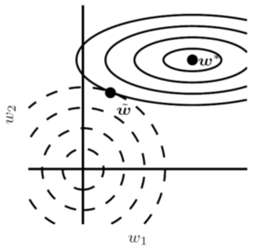
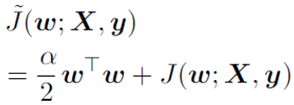
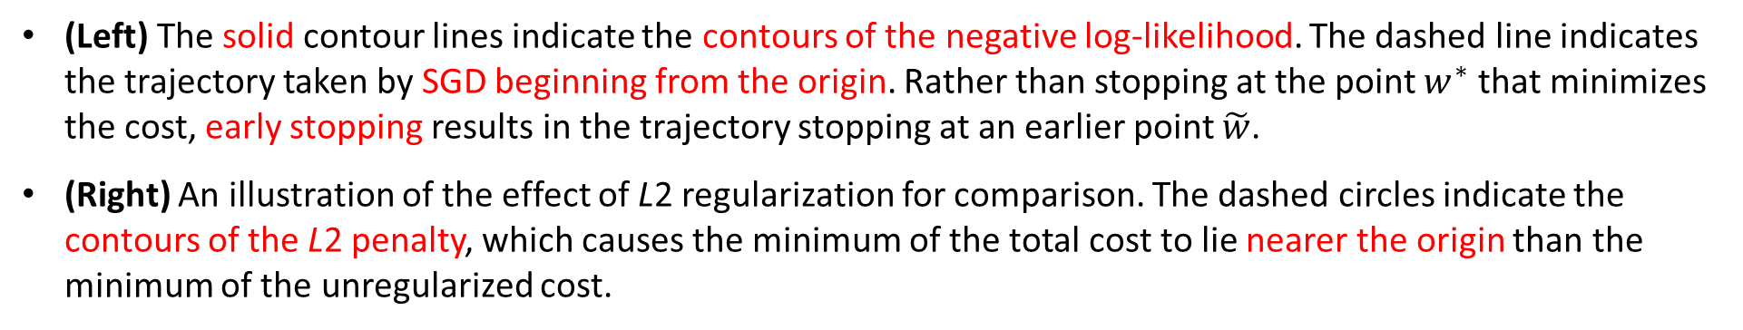
Early Stopping Weight Decay
Stop before weights become too large
Penalized with the L2 term
(Left) The solid contour lines indicate the contours of the negative log-likelihood. The dashed line indicates the trajectory taken by SGD beginning from the origin. Rather than stopping at the point $w^{∗}$ that minimizes the cost, early stopping results in the trajectory stopping at an earlier point $\tilde{w}$.
(Right) An illustration of the effect of L2 regularization for comparison. The dashed circles indicate the contours of the L2 penalty, which causes the minimum of the total cost to lie nearer the origin than the minimum of the unregularized cost.

Slide 19
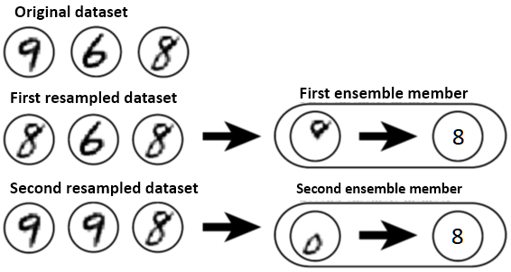
Bagging (An Ensemble Technique)
Bagging involves training multiple models, and evaluating multiple models on each test example.
Suppose we train an 8 detector on the dataset depicted above, containing an 8, a 6 and a 9. Suppose we make two different resampled datasets.
The bagging training procedure is to construct each of these datasets by sampling with replacement.
The first dataset omits the 9 and repeats the 8. On this dataset, the detector learns that a loop on top of the digit corresponds to an 8.
On the second dataset, we repeat the 9 and omit the 6. In this case, the detector learns that a loop on the bottom of the digit corresponds to an 8.
Each of these individual classification rules is brittle, but if we average their output then the detector is robust, achieving maximal confidence only when both loops of the 8 are present.

Slide 20
Dropout
For a base network with two visible units and two hidden units, there are sixteen possible subsets of these four units.
In this small example, a large proportion of the resulting networks have no input units or no path connecting the input to the output.
This problem becomes insignificant for networks with wider layers, where the probability of dropping all possible paths from inputs to outputs becomes smaller.

Slide 21
Example
with dropout
0/1
0/1
To perform forward propagation with dropout, we randomly sample a vector μ with one entry for each input or hidden unit in the network. The entries of μ are binary and are sampled independently from each other.
The probability of each entry being 1 is a hyperparameter, usually 0.5 for the hidden layers and 0.8 for the input.
Each unit in the network is multiplied by the corresponding mask, and then forward propagation continues through the rest of the network as usual.
0.5
0.5
0/1
0/1
0.8
0.8
0.8 probability
of being 1

Slide 22
Dropout
Dropout can be thought of as a method of making bagging practical for ensembles of very many large neural networks.
provides an inexpensive approximation to training and evaluating a bagged ensemble of exponentially many neural networks.
trains the ensemble consisting of all sub-networks that can be formed by removing non-output units from an underlying base network
One of the methods to implement dropout is to remove units from a network by multiplying its output value by zero.
Dropout can be applied to all of the input and hidden units.
Typically, an input unit is included with probability 0.8 and a hidden unit is included with probability 0.5.

Slide 23
Applying Dropout to Reduce Overfitting
import numpy
from keras.datasets import mnist
from keras.models import Sequential
from keras.layers import Dense
from keras.utils import np_utils
(X_train, y_train), (X_test, y_test) = mnist.load_data() # (tr: 60000, te: 10000)
Input
784
num_pixels = X_train.shape[1] * X_train.shape[2]
X_train = X_train.reshape(X_train.shape[0], num_pixels).astype('float32')
X_test = X_test.reshape(X_test.shape[0], num_pixels).astype('float32')
1000
y_train = np_utils.to_categorical(y_train)
y_test = np_utils.to_categorical(y_test)
num_classes = y_test.shape[1]
10
from keras.layers import Dropout, Activation
Output
model = Sequential()
model.add(Dense(1000, input_dim=784, activation='relu'))
model.add(Dropout(0.9)) //keep 0.9 and ignore 0.1 units
model.add(Dense(10, activation='softmax'))
model.compile(loss='categorical_crossentropy', optimizer='adam', metrics=['accuracy'])
history = model.fit(X_train, y_train, validation_data=(X_test, y_test), epochs=100, batch_size=1024, verbose=1)

Slide 24
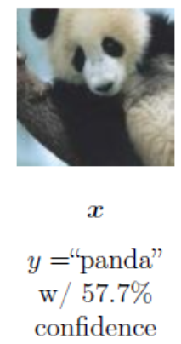
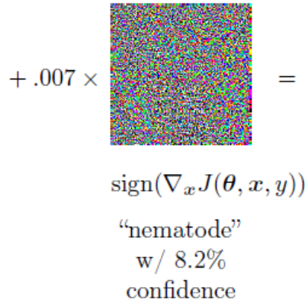
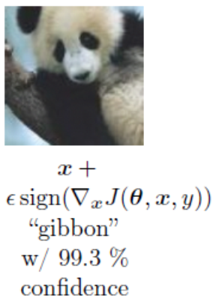
Adversarial Examples
Training on adversarial examples is mostly intended to improve security, but can sometimes provide generic regularization.
One can reduce the error rate on the original i.i.d. test set via adversarial training—training on adversarially perturbed examples from the training set.
Adversarial training requires the model should be invariant to all directions of change in the input as long as the change is small.
Figure 7.8: A demonstration of adversarial example generation applied to GoogLeNet on ImageNet. By adding an imperceptibly small vector whose elements are equal to the sign of the elements of the gradient of the cost function with respect to the input, we can change GoogLeNet’s classification of the image.
Notes:
Nematode: 線蟲綱動物(鉤蟲、蟯蟲); Gibbon: 長臂猿; imperceptibly: 不知不覺地

Slide 25
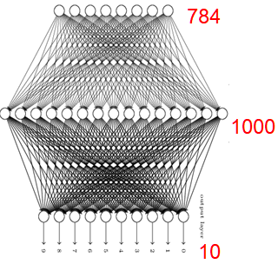
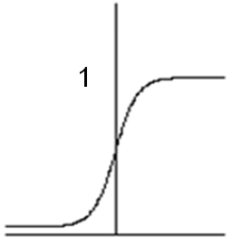

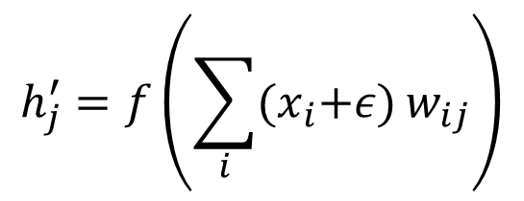
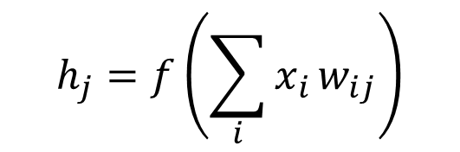

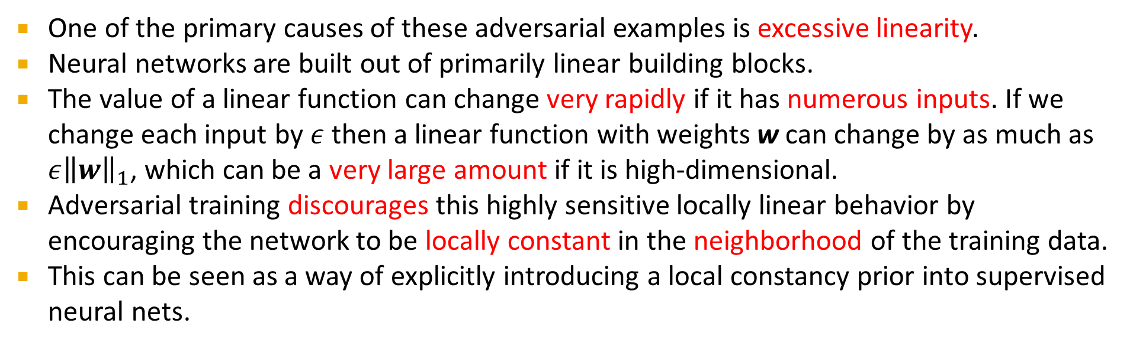
Adversarial Training
One of the primary causes of these adversarial examples is excessive linearity.
Neural networks are built out of primarily linear building blocks.
The value of a linear function can change very rapidly if it has numerous inputs. If we change each input by$ε$ then a linear function with weights w can change by as much as $ε{\left\|w\right\|}_{1}$, which can be a very large amount if it is high-dimensional.
Adversarial training discourages this highly sensitive locally linear behavior by encouraging the network to be locally constant in the neighborhood of the training data.
This can be seen as a way of explicitly introducing a local constancy prior into supervised neural nets.
x
$$h_{j}=f\left(\sum_{i}{x_{i}}w_{ij}\right)$$
$$h_{j}$$
w
h
$$h_{j}^{′}=f\left(\sum_{i}{{(x}_{i}+ε)}w_{ij}\right)$$

Slide 26
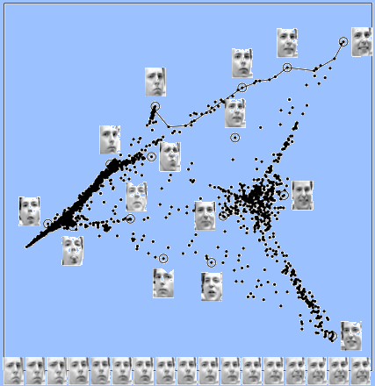
Tangent Propagation
We expect the classification function not to change as it moves along the class manifold.

Slide 27
Tangent Propagation
Figure 7.9: Both the tangent prop algorithm and manifold tangent classifier regularize the classifier output function f(x).
Each curve represents the manifold for a different class, illustrated here as a one-dimensional manifold embedded in a two-dimensional space.
On one curve, we have chosen a single point and drawn a vector that is tangent to the class manifold (parallel to and touching the manifold) and a vector that is normal to the class manifold (orthogonal to the manifold).
In multiple dimensions there may be many tangent directions and many normal directions. We expect the classification function to change rapidly as it moves in the direction normal to the manifold, and not to change as it moves along the class manifold.
Both tangent propagation and the manifold tangent classifier regularize f(x) to not change very much as x moves along the manifold. Tangent propagation requires the user to manually specify functions that compute the tangent directions (such as specifying that small translations of images remain in the same class manifold) while the manifold tangent classifier estimates the manifold tangent directions by training an autoencoder to fit the training data.

